Slide 1




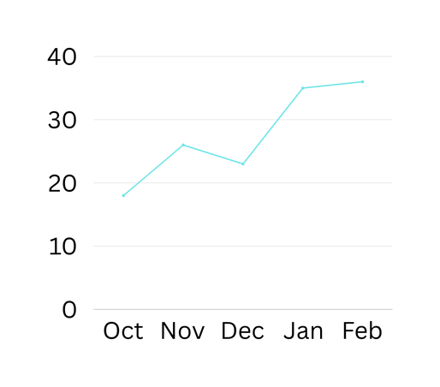
AI Risk Dashboard
Number of AI Risks Identified
56
% Mitigated Risks
72%
% High Severity Risks
16%
Top Risks
Bias
Data Leakage
Adversarial Attacks
Low
Low-Medium
Medium
Medium-High
High
Compliance Breach
Certain
Incidents
Likely
Possible
Unlikely
Rare

